Slide 1
CPRE Foundation Level
International Requirements Engineering Board

Slide 2
IREB - International Requirements Engineering Board
          Non-profit organization (2006)
          Create an internationally accepted and professional basis for RE
          Provider of CPRE
          Foundation – Advanced – Expert
CPRE Foundation
          Terminology of Requirements Engineering / Business Analysis and Requirements Management,
          Basic techniques and methods of Requirements Engineering
          What, Why, Where, How of Requirements Engineering
          69,800 professionals in 97 countries have passed the examination

Slide 3
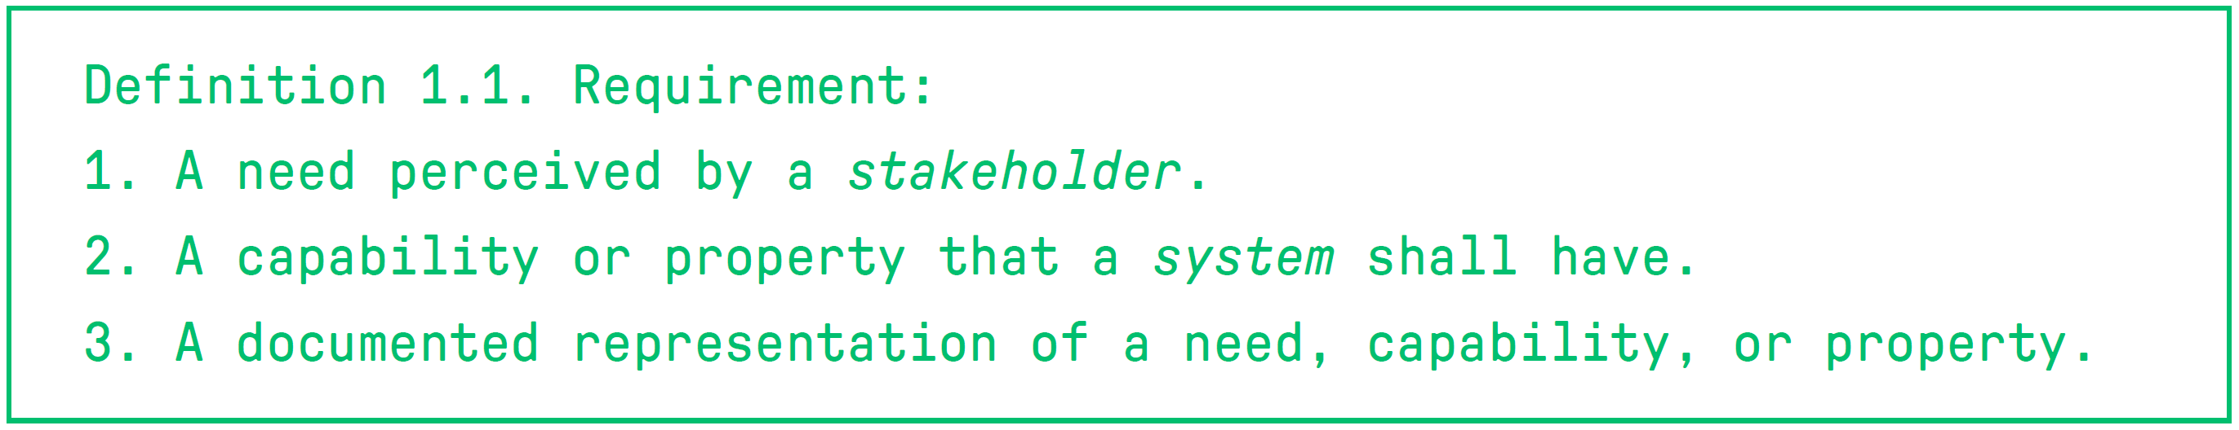
Requirements Engineering: What
            “The desires and needs to build new products or services, or to further develop existing products or services”
- Smartphone app -
Functional Requirements
Quality Requirements
Constraints
User Login: The app must have a feature that allows users to log in with their email and password.
Speed: The app should load messages and content quickly, with a response time of less than one second.
Regulatory: The app must comply with data privacy regulations, such as GDPR (General Data Protection Regulation).
Result or behavior that shall be provided
by a function of a system
Quality concerns that are not covered by
functional requirements - for example, performance, availability, security, or reliability
Limit the solution space beyond what is
necessary to meet the given functional requirements and quality
requirements
Notes:
- Dingen = producten, diensten,
- If the concern is about required results, behavior, or interactions, we have a functional requirement.
- If it is a quality concern that is not covered by the functional requirements, we have a quality requirement.
- If the concern is about restricting the solution space but is neither a functional nor a quality requirement, we have a constraint.

Slide 4
Requirements Engineering: What
            Functional Requirements (FR) = What
            Non Functional Requirements (NFR) = How (well)

Slide 5
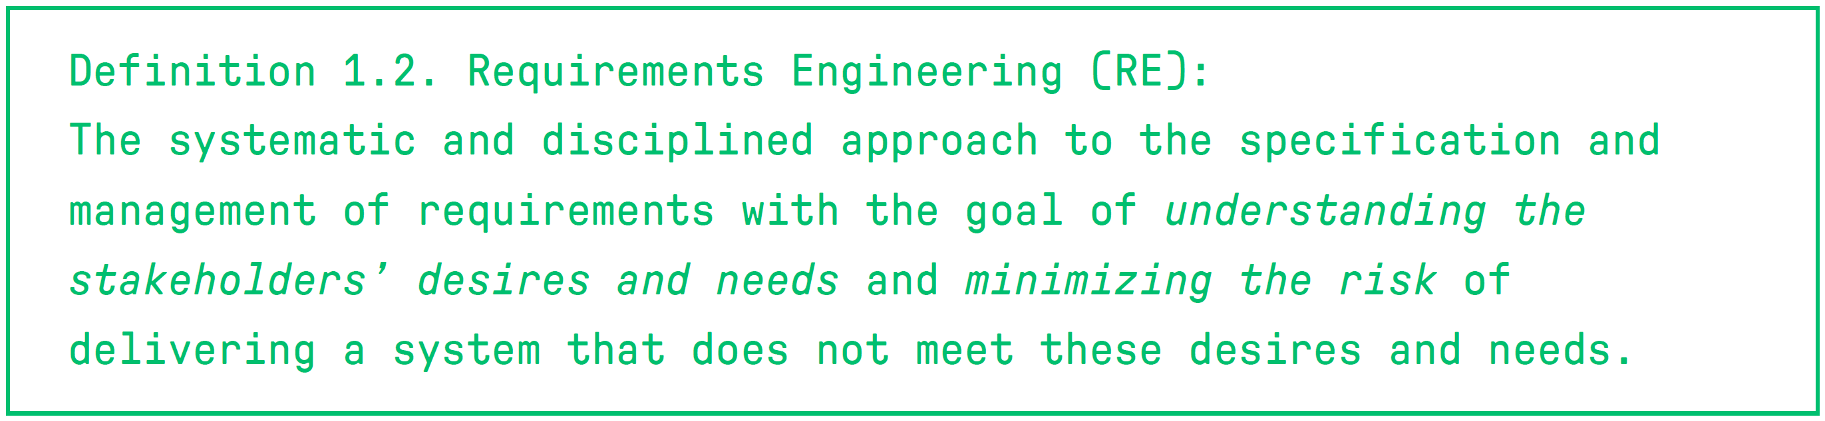
Requirements Engineering: What

Slide 6


Slide 7
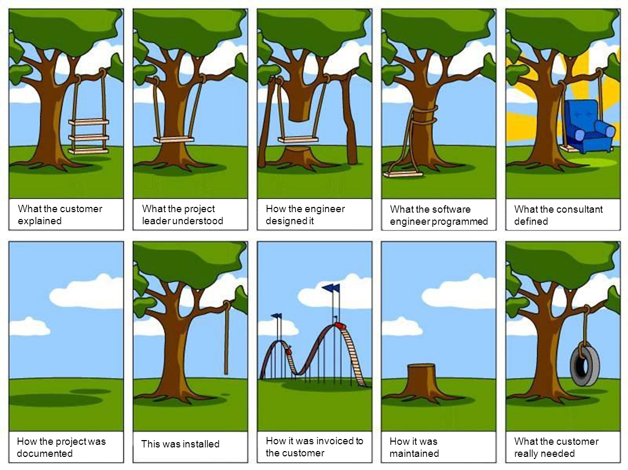

Slide 8

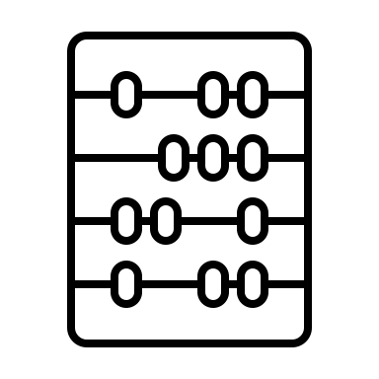


Adequate RE adds value
Testing
.
RE is a prerequisite for testing the system properly.
Estimation
.
RE provides a proper basis for estimating development effort and cost.
Minimization of failure or costly modifications in later development stages
.
The early detection and correction of wrong or missing requirements is much cheaper than the correction of errors and rework caused by missing or wrong requirements in later development stages or even after deployment of a system.
Eases the intellectual complexity
involved in understanding the problem that a system is supposed to solve and reflecting on potential solutions.
01
02
03
04

Slide 9




Symptoms of inadequate RE
Lack of skills
.
from people conducting RE activities
Testing
.
RE is a prerequisite for testing the system properly.
Estimation
.
RE provides a proper basis for estimating development effort and cost.
Assuming
.
the requirements are self-evident, which is wrong in most cases.
Rushing of development teams
.
right into implementing a system due to schedule pressure.
Minimization of failure or costly modifications in later development stages
.
The early detection and correction of wrong or missing requirements is much cheaper than the correction of errors and rework caused by missing or wrong requirements in later development stages or even after deployment of a system.
Eases the intellectual complexity
involved in understanding the problem that a system is supposed to solve and reflecting on potential solutions.
Communication problems between parties involved
.
in particular between stakeholders and system developers and among the stakeholders themselves.
01
02
03
04

Slide 10
Requirements Engineering
Management
& Tool Support
new sources identified
Source Analysis
Elicitation
Documentation
Validation
Requirement
Analysis
Conflict Resolution
conflicts detected
defects detected
sources overlooked

Slide 11
Requirements Engineering
Source Analysis

Slide 12



.
Involving
Identifying
Stakeholders
Source Engineering is a Continues Effort!
Sources
Sources
.
.
Documents
Other Systems
Analyzing
Notes:
Stakeholders are the main sources for requirements!

Slide 13

Stakeholders excited
First release planned
Data Privacy Regulations

Slide 14
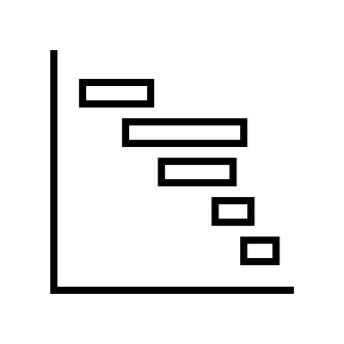



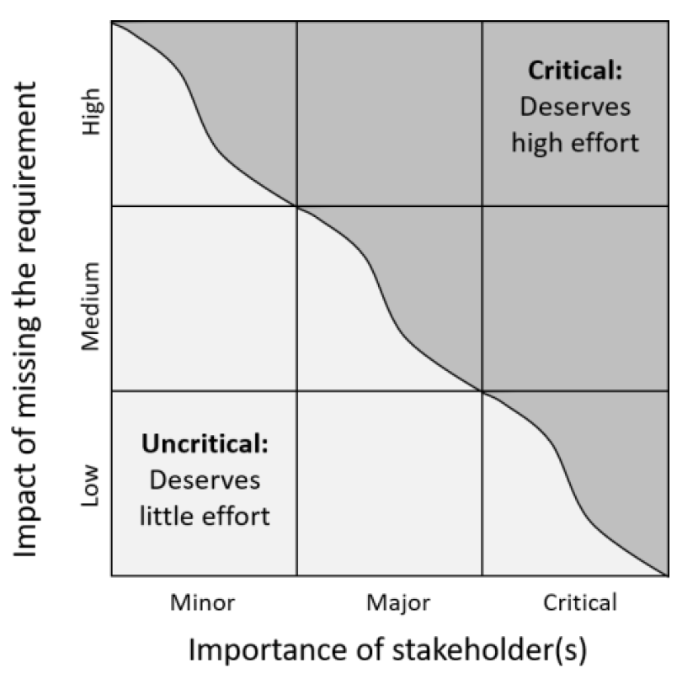




02 Stakeholders: RE is about satisfying the stakeholders’ desires and needs
Strategy
Customers
01 Stakeholder investigation
Who are all the stakeholders?
Global
Environment
Suppliers
02 Classify stakeholders
Split stakeholders in Minor, Major and Critical
Stakeholders
Regulators
Developers
Local Communities
Investors
03 Gather viewpoints and compare inconsistencies
Notes:
Challenges with many stakeholders:
Many different roles -> Stakeholder Analysis
Not all stakeholders are of importance -> classify influence (Minor, Major, Critical)
Different stakeholders have different viewpoints -> Gather all insights
Investigate when there are inconsistencies or conflicts!

Slide 15
Requirements Engineering
Source Analysis
Elicitation
Requirement
Analysis
Conflict Resolution

Slide 16
The effort expended by the Requirements Engineer to turn implicit desires, demands, wishes, needs, expectations
- which until now were hidden in their sources -
into explicit, understandable, recognizable, and verifiable requirements

Slide 17
Elicitation Techniques
Gathering
Questioning
Collaboration
Observation
Artifact-based
System archaeology
Interview
Workshops
Field observation
Feedback analysis
Questionnaire
Crowd-based RE
Apprenticing
Reuse of requirements
Design & idea-generating
Creativity
Design
Brainstorming
Analogy technique
Prototyping
Scenarios & storyboards

Slide 18
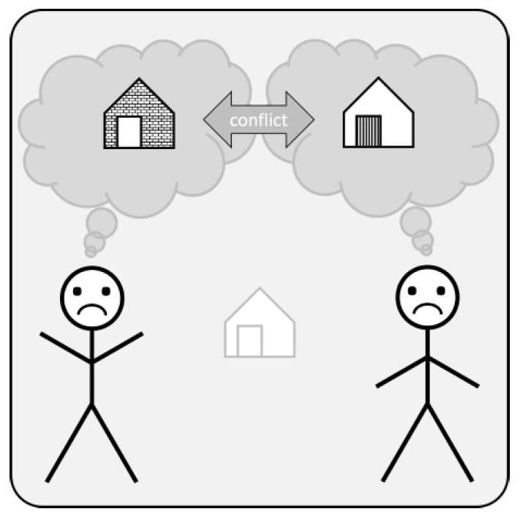
During elicitation, you gather a broad collection of requirements from different sources, with different techniques, and at different levels of abstraction and detail…
…so, requirements conflicts will ALWAYS occur!

Slide 19






Subject Matter Conflict
Data Conflict
Interest Conflict
Value Conflict
Relationship Conflict
Structural Conflict
Agreement
Completely understand each other’s positions and agree to a certain option preferred by all parties. Can be very time-consuming but if successful, it will provide additional motivation, so the result has a good chance of being long lasting
Compromis
Agree on an option that is not your preference but that you can live with because accepting the compromise is considered better than continuing the conflict. Is often next in line if an agreement cannot be reached in time. Can also be long lasting.
Voting
Works best when a relatively simple choice has to be made between a clear set of conflicting requirements. Stakeholders that participate in the voting should fully understand the alternatives and the consequences of their vote. You need to pay attention to the loser.
Overruling
If an agreement or a compromise cannot be reached and at least one of the conflicting parties refuses to participate in voting, overruling may be an option. As with voting, you may need to pay attention to the loser.
Definition of Variants
Building separate solutions for all conflicting requirements. May seem like a perfect solution but it comes at a price: it takes a lot of time, additional costs and growing complexity.

Slide 20
Requirements Engineering
Management
& Tool Support
new sources identified
Source Analysis
Elicitation
Documentation
Requirement
Analysis
Conflict Resolution

Slide 21







Natural Language Based
Template Based
Requirements spoken or written in natural language
Predefined structures for requirements
Documentation
Model Based
Other
An abstract representation of requirements
Work Products that do not fit in the previous categories, f.e. prototypes

Slide 22


Incomplete Descriptions
. .
When writing a requirement in natural language, all placeholders of the verb used should be filled.
.
❌ The system should notify when an error occurs
.
✅ The system should notify administrators when an error occurs
Incomplete Comparisons
. .
In technical writing, comparisons should include a reference object.
.
❌ The system should provide faster response times
.
✅ The system should provide response times faster than 0.1 ms
Universal Quantifiers
. .
Universal quantifiers are words which are used to make statements that are universally true. In technical systems, however, such universal properties are rare
.
❌ The system should always respond within 1 millisecond
.
✅ The system should aim to respond within 1 millisecond under normal operating conditions
Unspecific Nouns
. .
Unspecific nouns should be made more specific by adding adjectives or assigning them a well-defined type.
.
❌ Develop a system that processes the data and provides a user-friendly interface
.
✅ Develop a system that processes customer purchase history data and provides a user-friendly interface
Passive Voice
. .
If a requirement is stated in the passive voice, this may hide who is responsible for the action described in the requirement
.
❌ Errors should be detected and logged by the system
.
✅ The system should detect and log errors
Unspecific!
Incomplete Conditions
. .
When something happens only if certain conditions are true, such conditions shall be stated, providing both then and else clauses.
.
❌ The system should calculate and display the total order amount
.
✅ The system should calculate and display the total order amount. IF there are any items with discounted prices or special promotions, THEN the system should reflect these adjustments in the calculated total; ELSE, the displayed total should represent the standard pricing for all items
Nominalization
.
A nominalization may hide unspecified requirements. F.e. assuming that certain procedures already exist
.
❌ Only after successful authentication, the system shall provide user access to the customer purchase history
.
✅ The system must implement a procedure to authenticate users successfully before providing access to customer purchase history
Notes:
Noun = Zelfstandig Naamwoord (dingen waar je de, het en een voor kan zetten)

Slide 23
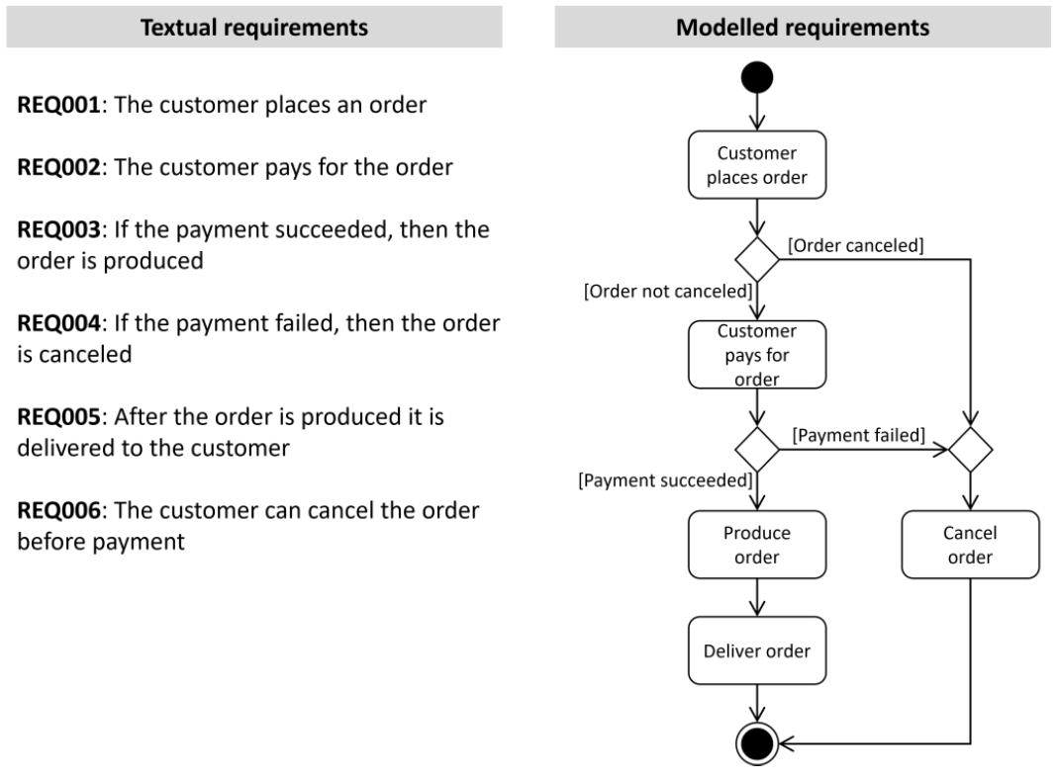
Notes:
Functionele requirements!

Slide 24
Natural Language Based
Template Based
Requirements spoken or written in natural language
Predefined structures for requirements
Documentation
Model Based
Other
An abstract representation of requirements
Work Products that do not fit in the previous categories, f.e. prototypes

Slide 25
Requirements Engineering
new sources identified
Source Analysis
Elicitation
Documentation
Validation
Requirement
Analysis
Conflict Resolution

Slide 26
Validation
What the customer needs
Expectation
Gap
Expectation
Gap
What the developer build
Time

Slide 27











Validation Techniques
Static
Concentrate on analyzing the specifications of a system without executing it
Dynamic
Looks at the (actual or simulated) behavior of the operative system as experienced by the users through the user interfaces
Reviews
Visual study of early and intermediate work products.
Range from informal to very formal
Applied from the very beginning of a project until the implementation of the system.
Sample Development
A set of requirements is provided as input for developers; they try to produce some common intermediate work products (e.g., codes, test cases, etc.) based on this input.
The system itself is not operative (yet)
During this effort, the developers may detect flaws such as unclarities, omissions, and inconsistencies that prevent them from producing their intended output.
Exploratory
Offers a group of stakeholders the opportunity to gain hands-on experience with an intermediate version of the system under development.
Stakeholders look at the (actual or simulated) behavior of the operative system as experienced by the users through the user interfaces.
Exploratory techniques are common in iterative and design thinking development approaches.
Walkthroughs
Author of a work product explains it step by step to an audience in an interactive session.
Best applied in an early project phase, or on the transfer of an intermediate work product to another party who will use it as input for subsequent development.
Inspection
Most formal review technique
Performed in the form of a meeting with the moderator (independent review leader), the author (listener), and a group of inspectors (who check the work product).
Prototyping
Specific early version of the system is given to a group of stakeholders for evaluation
Allows stakeholders to gain hands-on experience while the internal structure may still be unfinished, inoperative, or even completely missing.
Alpha / Beta Testing
A fully featured, completely working preproduction version of the system is provided to end users in a realistic environment.
Alpha testing is done at the developer’s site in a simulated environment
Beta testing is conducted at the end user's sites in real production.
A/B testing
The system is offered to different (mostly randomly selected) groups of users in two variants that differ in design or functionality and realize the user goals in a different way.
The reaction of both groups is measured and compared.
Notes:
Prototyping: may be explicitly built for validation purposes, after which it is discarded; we call this an exploratory or throwaway prototype. Of course, evolutionary prototypes, which are continuously updated and extended until they end up in the final product, can also be used for validation during their development.

Slide 28
Requirements Engineering
Management
& Tool Support
new sources identified
Source Analysis
Elicitation
Documentation
Validation
Requirement
Analysis
Conflict Resolution
conflicts detected
defects detected
sources overlooked
Notes:
“The process of managing existing requirements and requirements related work products, including the storing, changing and tracing of requirements.”

Slide 29
Breakout Session | Requirements Engineering SWOT Analysis
          Objective: Identify strengths, weaknesses, opportunities, and threats (SWOT) related to your current approach to requirements.
          Format: Divide into groups and provide a blank SWOT template (Strengths, Weaknesses, Opportunities, Threats). Focus the discussion with prompts:
            Strengths: What are we doing well in our requirements process?
            Weaknesses: Where do we struggle the most in defining and managing requirements?
            Opportunities: What practices or tools could we adopt to improve?
            Threats: What risks do we face if we ignore proper requirements engineering?
Task: Each group fills out their SWOT and reflects on how to turn weaknesses into strengths and threats into opportunities.

Slide 30

IIBA IREB
Focus on six knowledge areas BAPM,E&C, RLCM, SA,RADD & SE
Offers practical guidance on performing business analysis tasks
Offers three main certifications (ECBA, CCBA, CBAP) based on experience levels
Suitable if you want a broader focus on business analysis, including strategy analysis, solution evaluation, and requirements management
Designed for business analysts, project managers, and professionals involved in various aspects of business analysis
Except ECBA, both core certification require renewal every 3 years
Focuses on requirements elicitation, documentation, validation, and management
Practical and hands-on approach towards requirements engineering
Has three levels (Foundation, Advanced, Expert) focusing on different depths of knowledge
Ideal if you aim to specialize in requirements engineering, focusing on elicitation, documentation, and validation of requirements
Geared towards professionals involved in requirements engineering, software development, and system integration
Certification is valid for life once obtained

Slide 31
What do we recommend !!!
Consider which areas you are more passionate about
  If you enjoy detailed requirements work, IREB CPRE might be more appealing
  If you prefer a broader scope of BA activities, IIBA could be a better fit
Certification renewal
Certification Levels and Path
  IREB CPRE: Offers a clear progression from Foundation to Expert level, focusing on deepening your expertise in requirements engineering
  IIBA : Provides a tiered certification path (ECBA, CCBA, CBAP) based on your experience level, allowing you to grow your business analysis skills progressively
The best certification for you is the one that align with your career aspirations, current role, and personal interests.

Slide 32


“Aspire, Achieve, Advance: Elevate Your Learning journey with Our Study group today!”
Analysis changes everything

